Slide 1
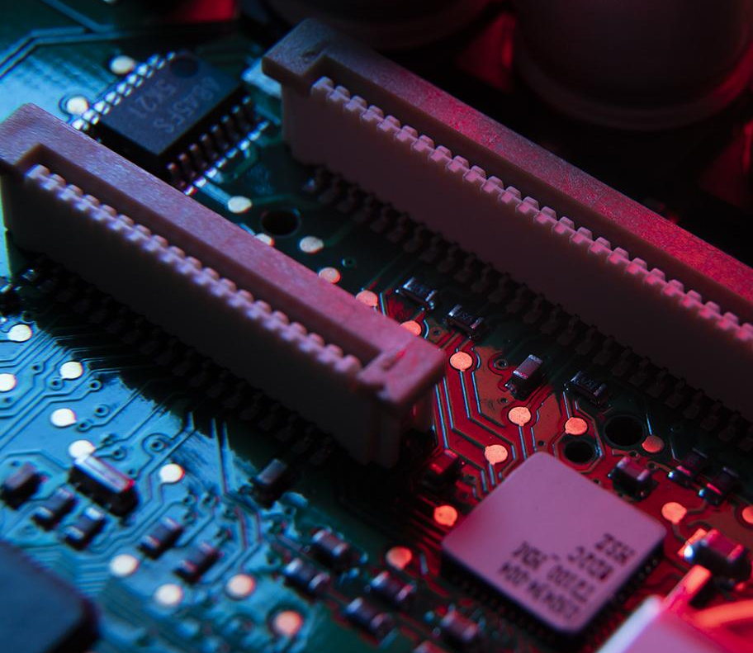

Lensless Digital Holographic Microscope
Group 7

Slide 2

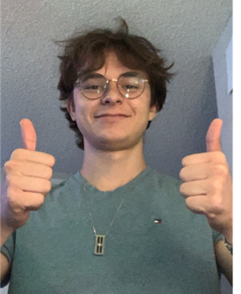

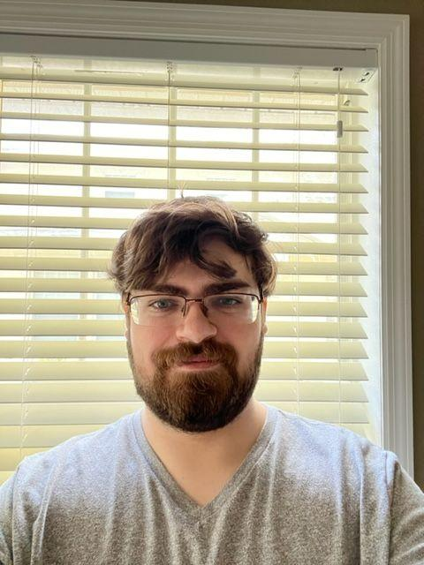
Meet Our Team - Group 7
Nicolas Bonaduce
Photonics Engineer
Parker Crooks
Photonics Engineer
Julian Correa
Computer Engineer
Nick Scarlata
Electrical Engineer
Notes:
-P

Slide 3
Project Description
Lensless microscope that digitally images holograms onto a computer application
  Microscope 1: High-Power LED (450 nm) with pinhole aperture
  Microscope 2: Fiber optics attached to an LED array
  Back-propagation
  Shift-and-add pixel super-resolution of in-line holograms
Notes:
-P

Slide 4
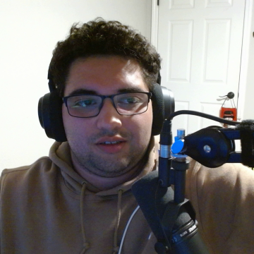
Key Goals
Couple LED array into Fiber Optic Array efficiently
Sequentially set off the LED’s at variable timing (To image in sync w/ CMOS Sensor)
Calculate formulas for different wavelengths/image-subjects into an excel chart for variable imaging.
Ensure CMOS works well with a variety of softwares
Pixel Super Resolve recorded holograms with algorithms
Ensure power supply is sufficient for the system.
Notes:
Some of our key goals for the project are to efficenlty couple an array of LEDs into a fiber optic array which will allow us to sequentially set of these LEDs to be timed in in sync with the image capturing process by the CMOS sensor. We then calculate the formuals needed for the different wavelengths and image-subjects in an excel chart so variable imaging will be easier and efficient. With all this in mind we ensure that the CMOS sensor works well with the varity of softwares that are used. From the recorded holograms we Pixel super resolve them with algorithms above all else ensure that the power supplied into the system is enough to run the system.

Slide 5
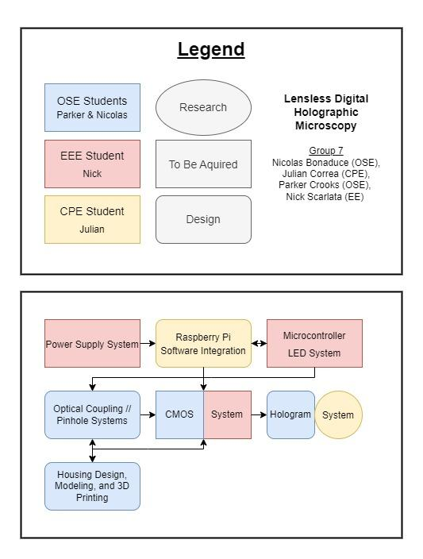
Block Diagram
The following diagram represents the distribution of responsibilities between the group members. The legend outlines the colors and shapes used in the block diagram.
Notes:
-P

Slide 6
Optical Specifications
Optical Specifications
Component | Parameter | Specification
High Power LED | Wavelength Range | 450 nm – 465 nm
High Power LED | Max Drive Current | 1 A (1000 mA)
High Power LED | Forward Voltage | 3.1 V typical, 3,5 V max
LED | Wavelength | 630 nm
LED | Half Angle | 20 degrees
LED | Luminous Intensity | 125.7 Lumens
LED | Max Drive Current | 30 mA
LED | Forward Voltage | 2.2 V typical, 2.8 V max
Single-Mode Fiber | Wavelength Range | 488 nm - 633 nm
Single-Mode Fiber | Cladding Diameter | 125 µm
CMOS Sensor | Pixel Size | 3 µm x 3 µm
CMOS Sensor | Number of Effective Pixel | 1920x1200
CMOS Sensor | Frame Rate | 48 fps @ 1920x1200
CMOS Sensor | Focal Length | 3.6 mm
Notes:
-P

Slide 7
Engineering Requirements
Engineering Requirements | Values
Cost | >$800
Power | <10V
Microcontroller | <40s latency while being able to control the system
Optics | Can visualize a subject between <250 µm
App | <60s latency
CMOS Sensor | Pixel size of >3 x 3 µm
LEDs | An array of 24 at 220 lumens
Notes:
-P

Slide 8
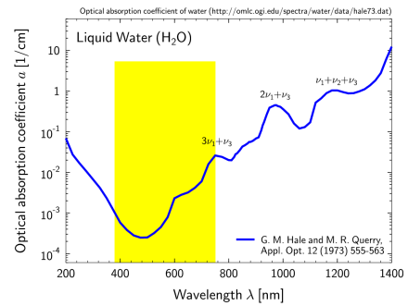
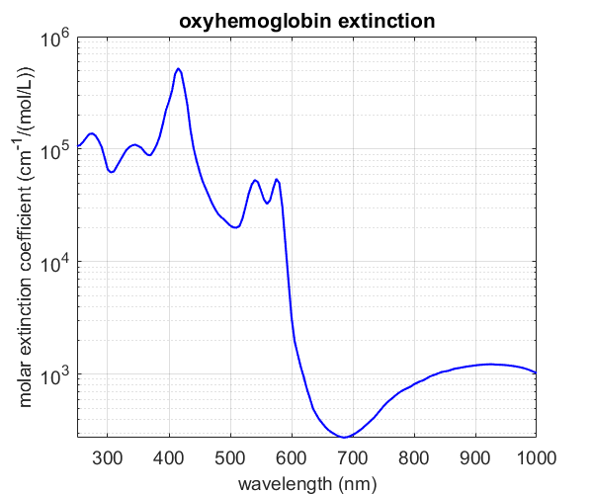

Absorption Spectrums of our Samples
Absorption Spectrum of Water
Absorption Spectrum of Blood

Slide 9
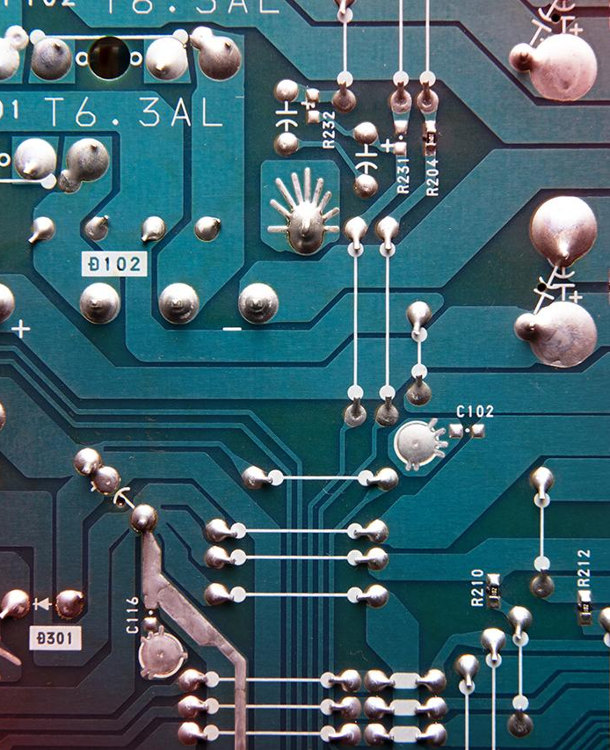
01
Chassis
Design

Slide 10
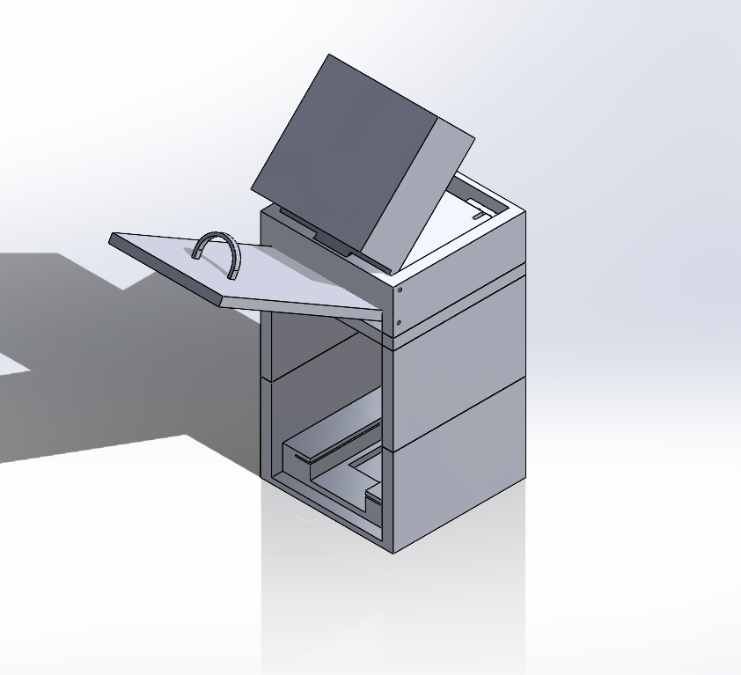
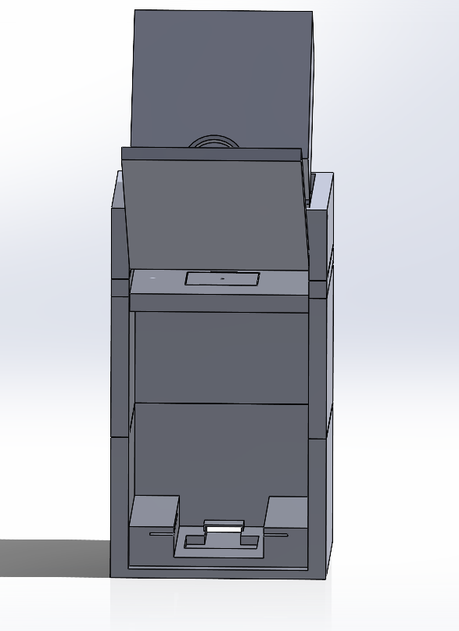
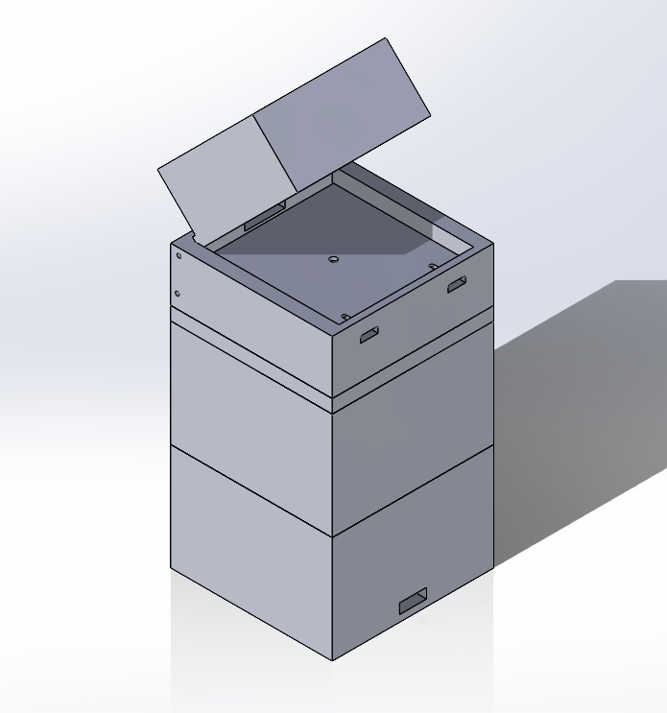
Chassis Design
Overall Schematic - Pinhole Microscope

Slide 11
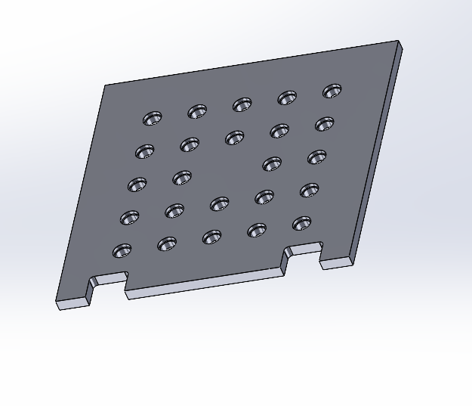
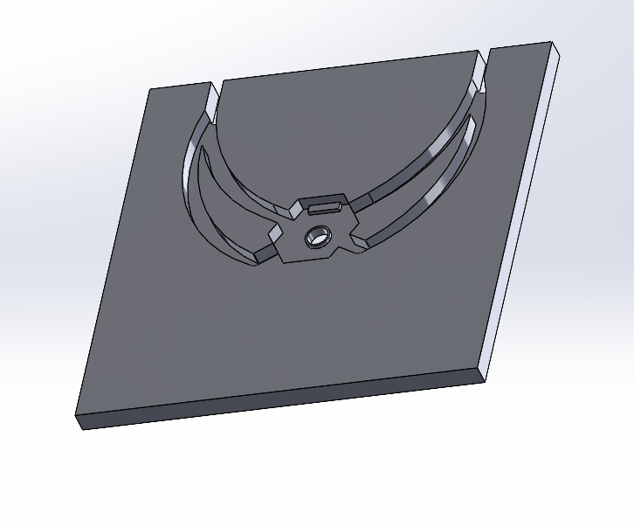
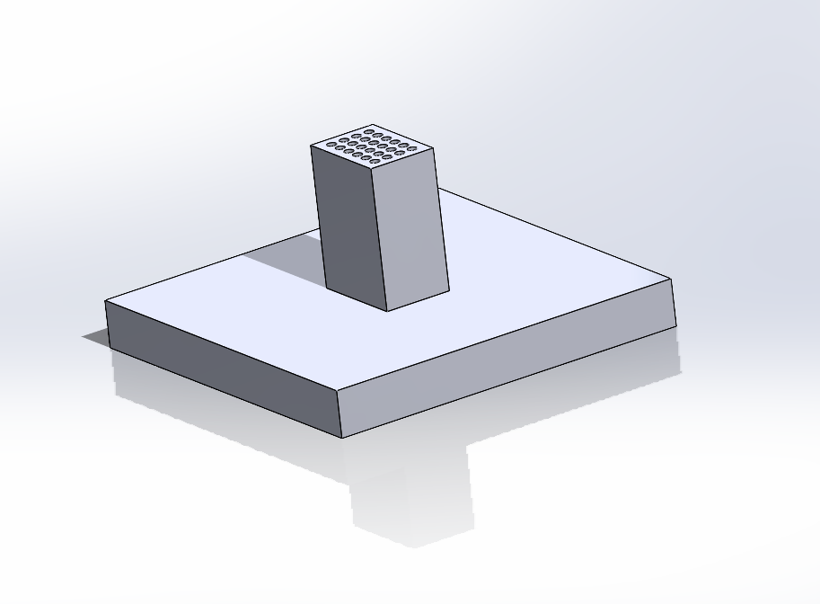
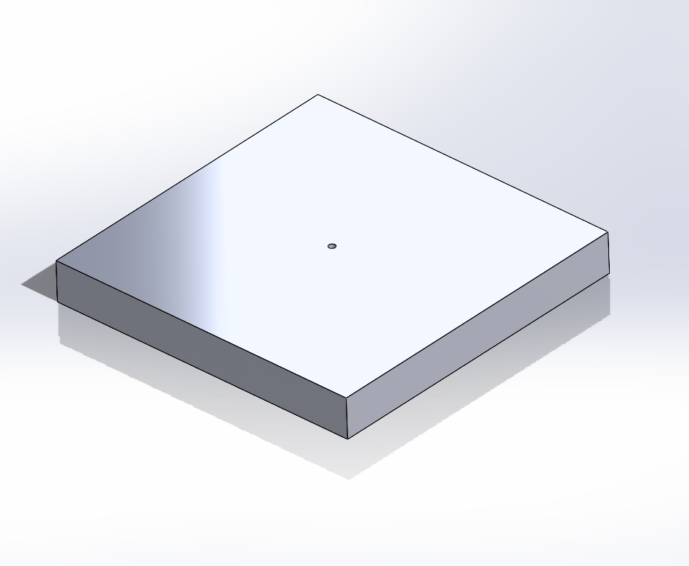
Chassis Design
Array Planes
Sequentially Firing LED Array
High Power LED Array
Fiber Optic Array
Pinhole Array

Slide 12
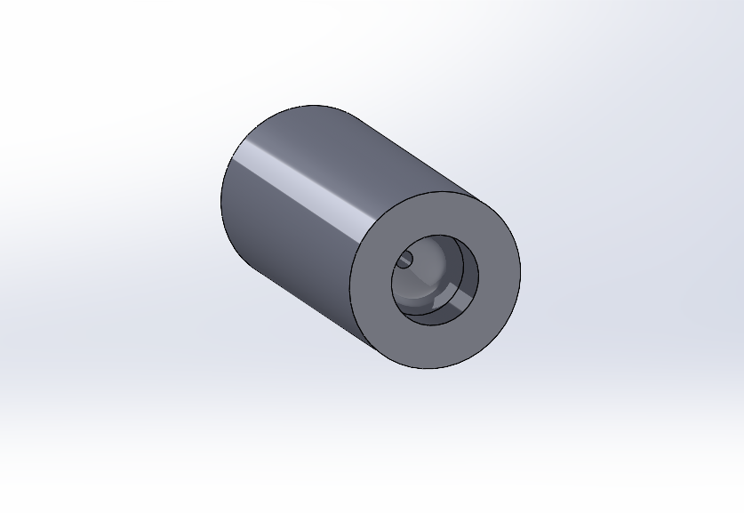
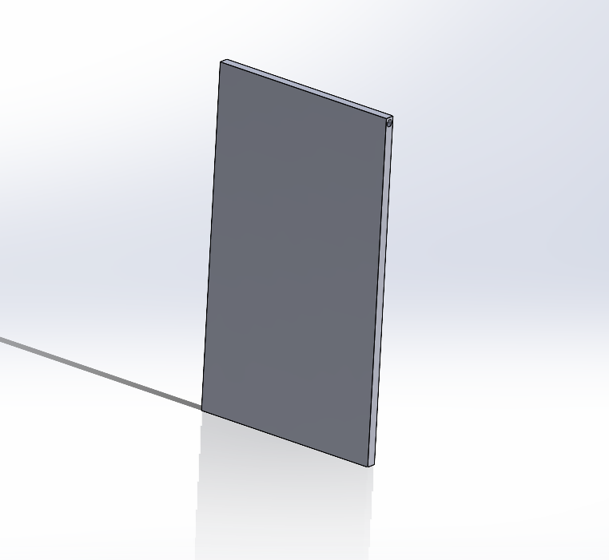
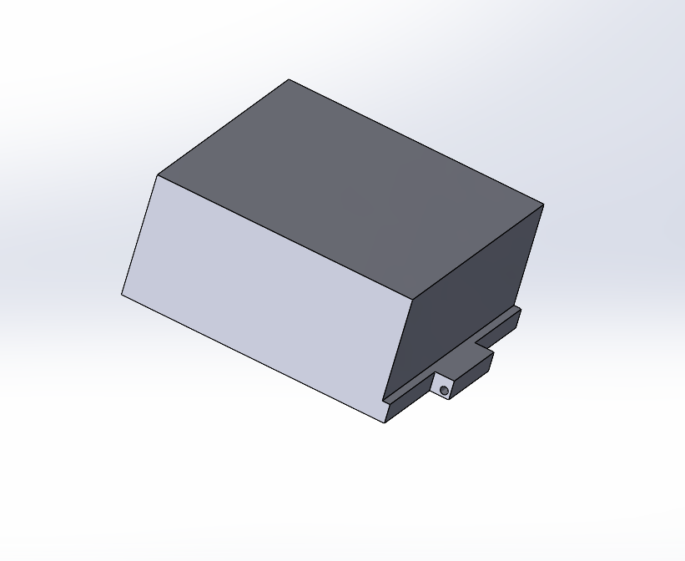
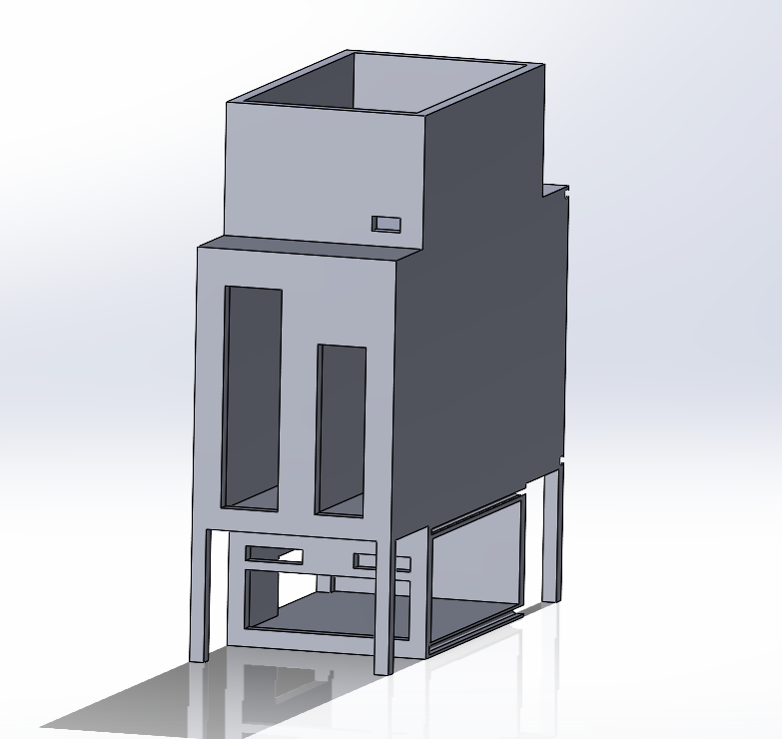
Chassis Design
Other Parts
Fiber Chuck
Front Door Hatch
Top Hatch
Electrical Box

Slide 13
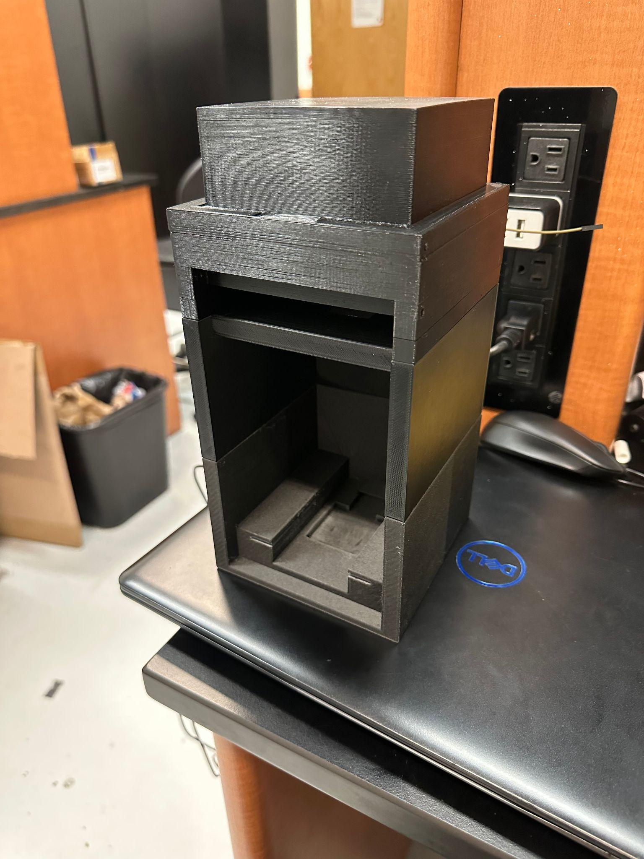
02
Chassis
Construction

Slide 14
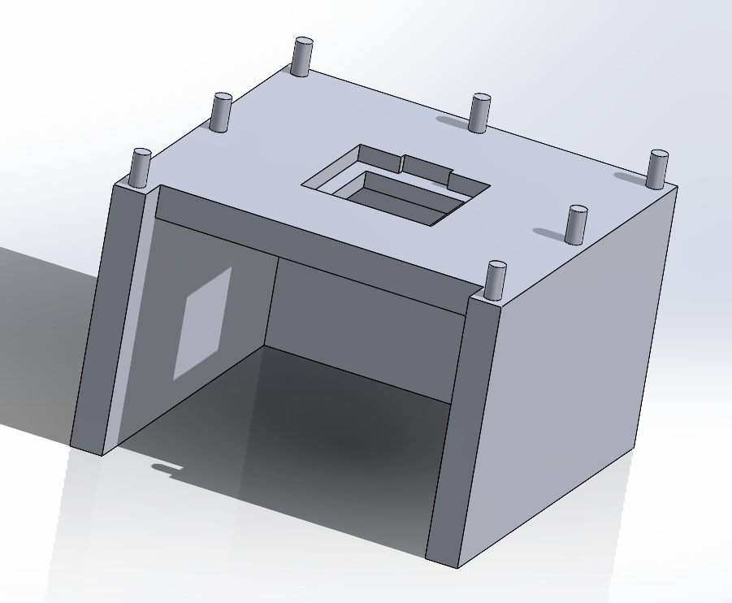
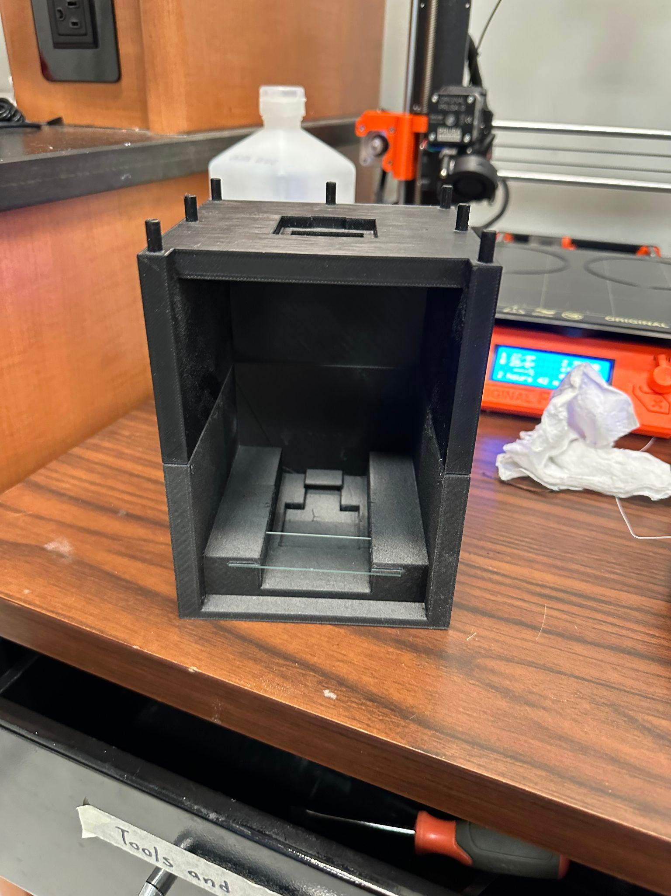
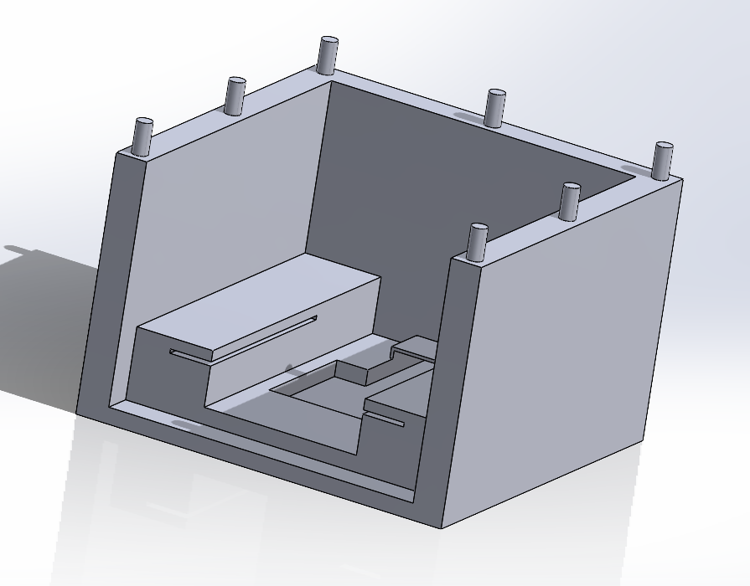
Chassis Construction

Slide 15
03
Electrical
Design and Integration

Slide 16
Electrical Goals and Objectives
Goals
Have a source of power either on board or using the device it is mounted to for power
Find a reasonable CMOS sensor
Find a microcontroller that can accomplish the tasks of the device
LEDs (25)
Objectives
Find a reasonable power source for all the electrical components
Ensure the wiring of said components is correct according to a Schematic diagram

Slide 17
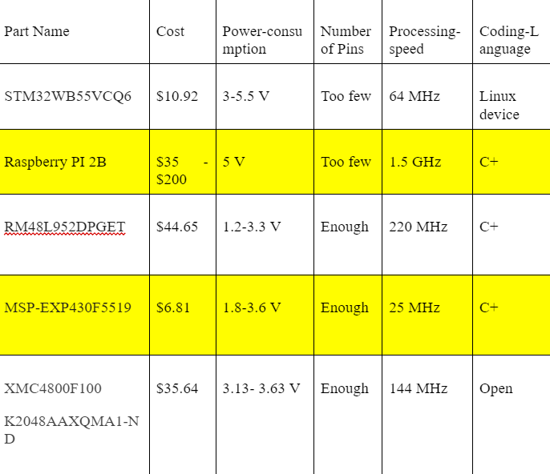
Microcontroller
Raspberry PI
On board computer, the main connector for the rest of the system electrically
Able to take,store, and send pictures via the CMOS sensor
MSP430F5519
Simple PCB design enabling a simple control over the LED array

Slide 18
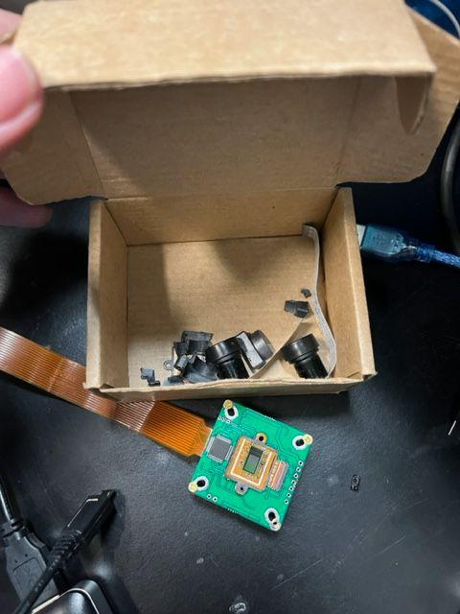
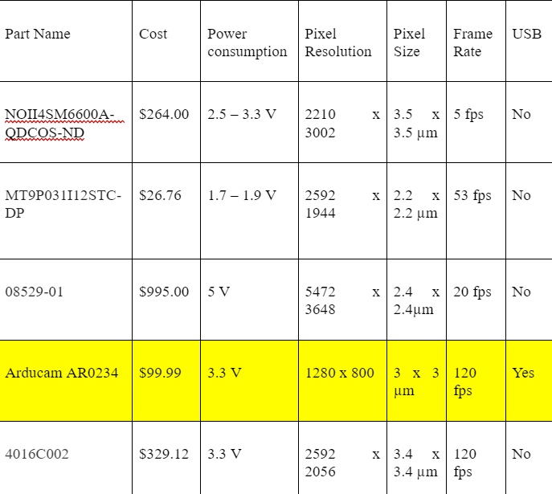
CMOS Sensor
AR0234
Meets the specifications and is able to be implemented
Interesting Process
This was a part with a lens originally which has been removed entirely, by somewhat destructive means.

Slide 19
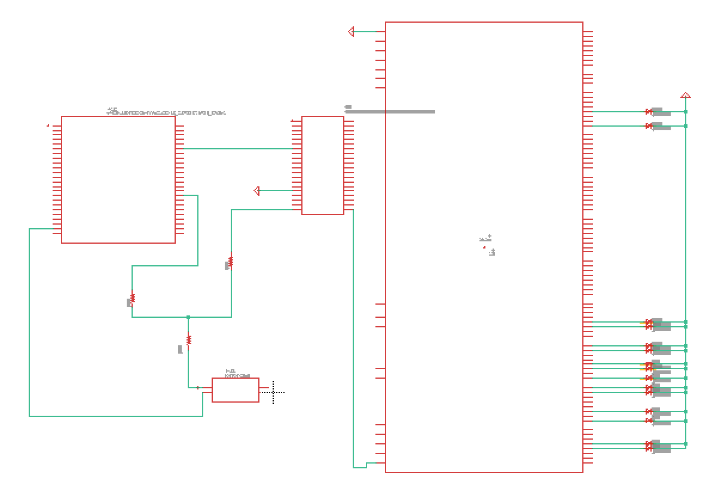
Circuit Design
From left to right:
CMOS sensor
Power Source 5V @2A
Raspberry PI
MSP430
LED array
Notes:
-Nick

Slide 20
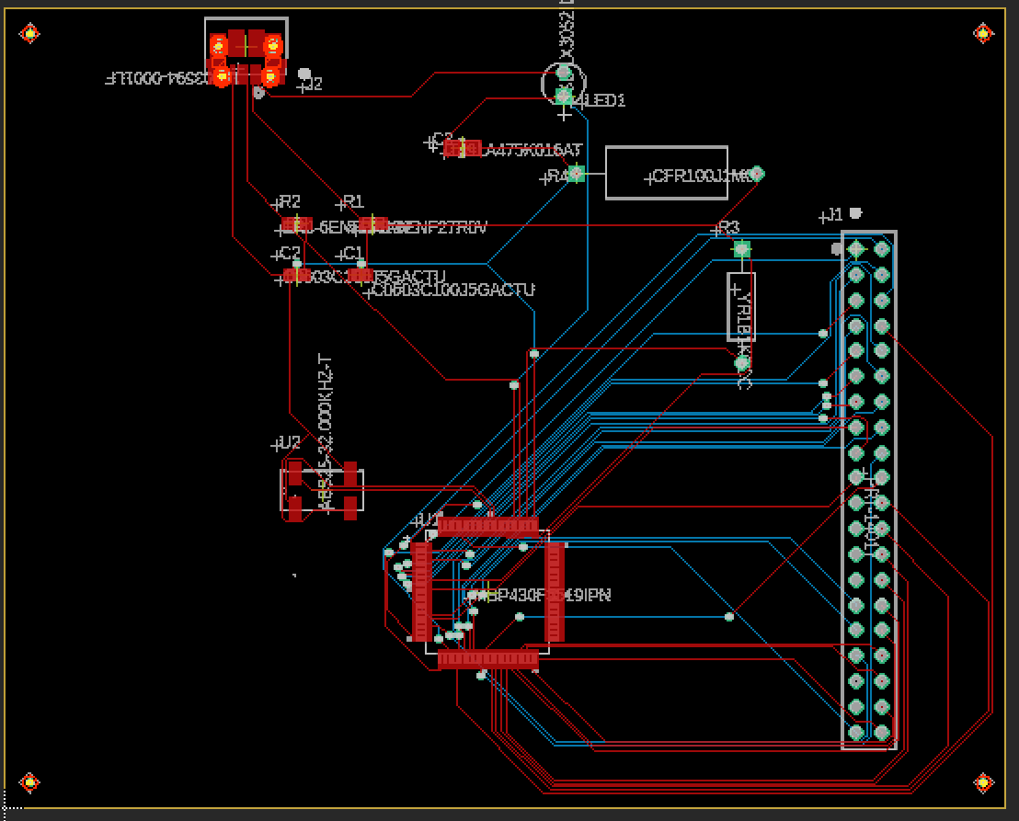
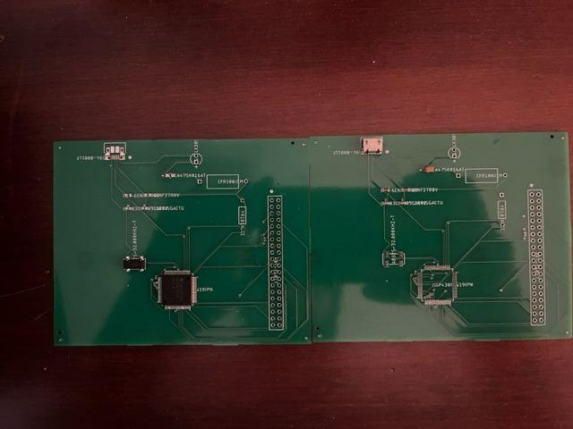
PCB
This is the PCB that contains the MSP430F5519 microcontroller, between shipping delays, and manufacturer errors I was unable to get this part working for testing.
For the purposes of testing and demonstration the MSP430FR6989 was used instead.
This part should work and would save around seven dollars in costs, not counting shipping.
Notes:
-Nick

Slide 21
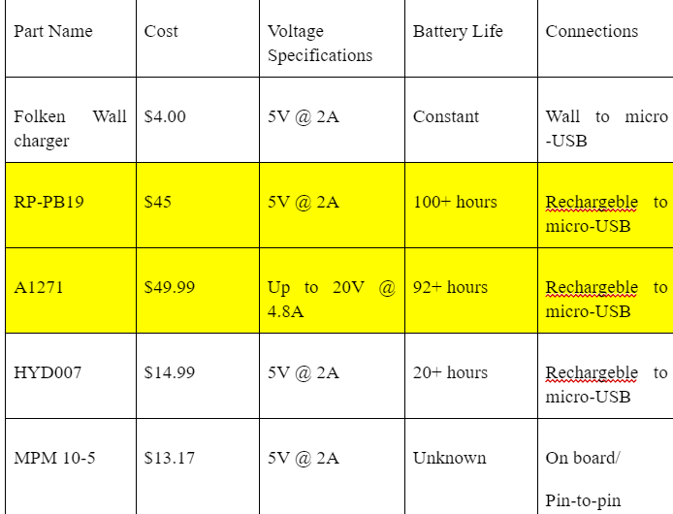
Power Supply
In short the goal of this power source is to meet the voltage and current requirements of the Raspberry PI 2B
This just requires 5 V @ 2 A, we did the testing and pretty much any rechargeable battery with a USB port fills this role very well
A pin-to-pin connection works just as well put the power sources are less reliable than the micro-USB connection
We went with a more expensive version to make development more convenient, but a cheaper version works just as well.

Slide 22
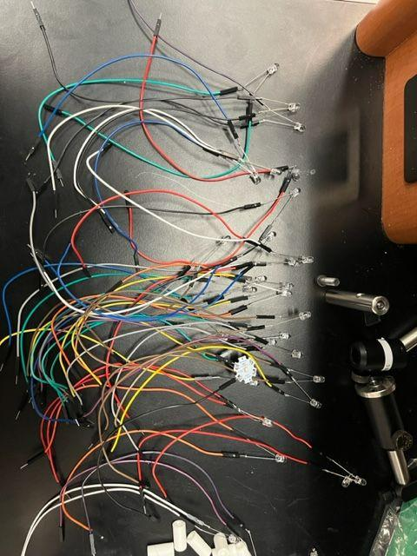
LED Connection
Due to the LEDs needing to be fired sequentially we only need to power each pin on at a time
The microcontroller that we are using has more than enough female pins allowing for a direct F-M connection with the LED, and a M-M connection to a line leading to ground

Slide 23
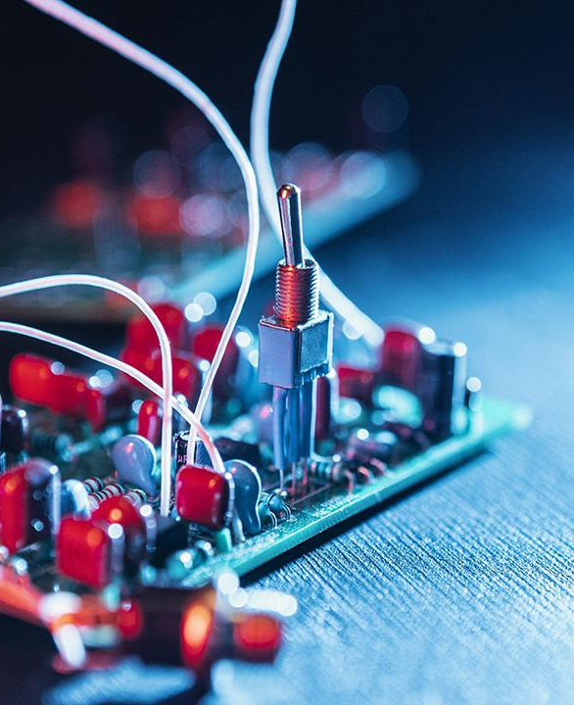
04
Software
Design

Slide 24
Code Comparison
 | C | C++ | C# | MATLAB | Python
Paradigm(s) | Imperative | Imperative,object-oriented, generic | Imperative, object-oriented, generic, reflective, functional, event-driven | Procedural, imperative, array programming | Functional, imperative, reflective, array
Type Discipline | Static, weakly typed | Static, dynamic, weakly typed | Statically typed, dynamic (for interop) | Dynamic | Strong, Dynamically typed
Parameter passing methods | By value, by reference (through pointers) | By value, by reference (through reference types) | By value, by reference (through managed pointers [explicitly in, out, or in-out]) | By value | By value (Call by object reference)
Intended use | System, Embedded | System, Embedded | System, Embedded | Numeric computation and visualization | System, Embedded
Best For | Scripting of system applications, web services, and web applications | Supporting object-oriented programming features | Development of desktop applications, web services, and web applications | Engineering and scientific applications like data analysis, signal and image processing, control systems, wireless communications, and robotics | Data analytics, machine learning, even design
Advantages | Fundamental block for many other programming languages, portable language, middle-level and structural language, built-in functions | Mid-level programming language, high portability, fast and powerful, standard library, multi-paradigm | Effective memory management, fast and powerful, standard library, object-oriented | Highly suitable for scientific and technical data analysis, Ease of use, Platform Independence, Device-Independent Plotting, Graphical User Interface, MATLAB Compiler | Enhanced productivity, easy to learn and write, dynamically typed, vast library support, hassle-free portability, High versatility and data visualization

Slide 25
Software Goals
Goals
Implement phase retrieval with the use of deep learning
Have the ability to generate an in-line hologram/ Gabor Hologram
Create a focused image with the use of simple backpropagation in order to create a focused and defocused image (two-image artifact)
Implement the “shift-and-add” in order to take low-resolution holograms and up-sample, shift, and digitally add them in order to create a good image
Implement digital hologram reconstruction (digital back-propagation) with the method of angular spectrum method

Slide 26

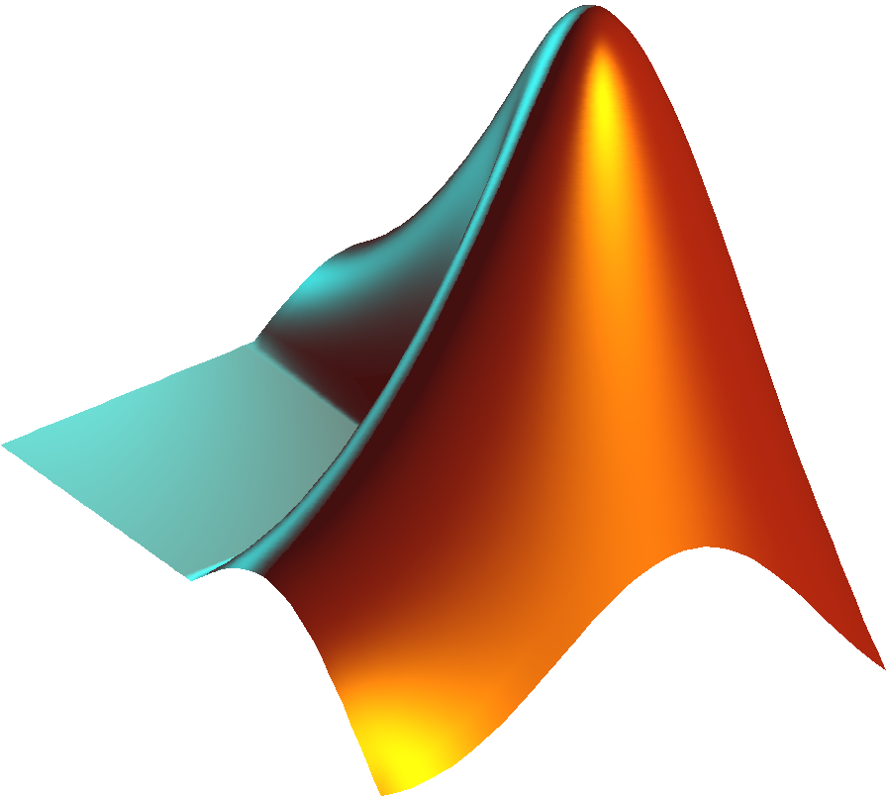
Software Design Approach
Data transmission and processing:
Be able to transmit the images from the CMOS Sensor to the computer to use the algorithms and principles in order to get a image to show
MATLAB:
Use for testing and creation of algorithms and equations
Coding:
The coding for the CMOS Sensor and its algorithms will be done in python
Microcontroller coding will be done in C
Notes:
-Mauricio

Slide 27
05
Software
Integration

Slide 28
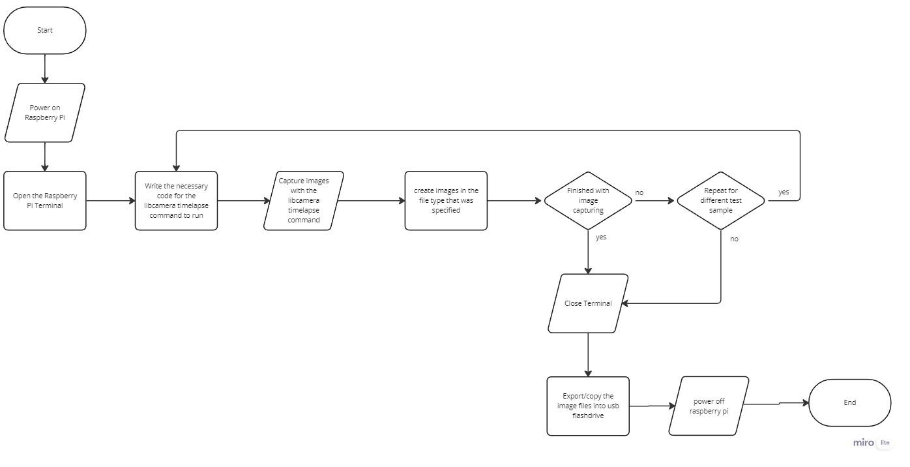
Image Capturing Process

Slide 29
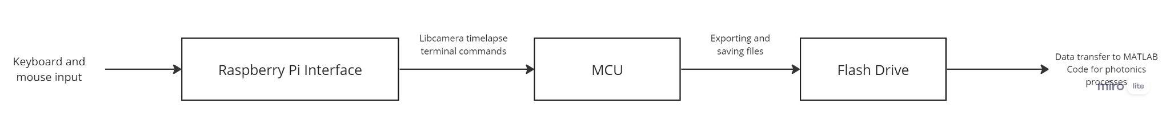
Image capture data processing

Slide 30
Photonic Methods and Principles
Holography and Digital In-Line Holography
  Gabor in-line holography
Propagation and Back-Propagation
Angular Spectrum Method

Slide 31
Photonics Methods and Principles cont.
Twin image Artifact Removal
Pixel Super-Resolution
Spatial Convolution
Phase Retrieval
Pixel Pitch

Slide 32
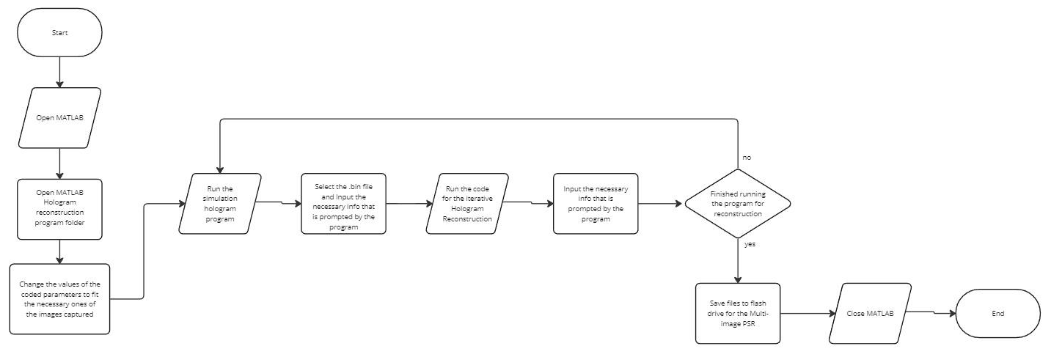
Hologram Reconstruction Process

Slide 33
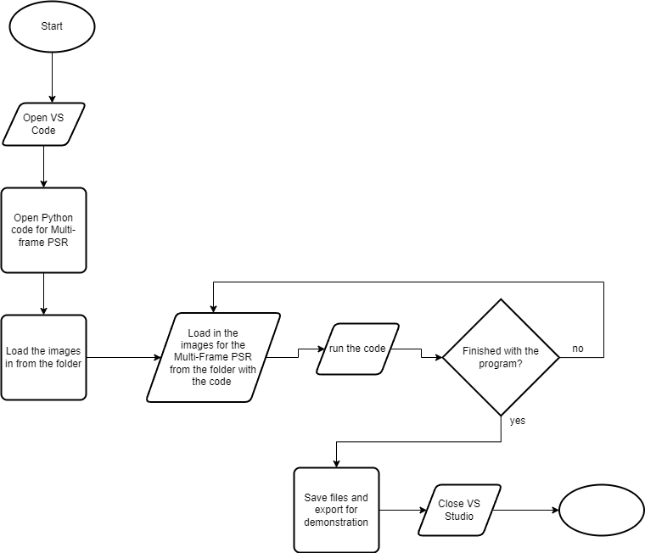
Multi-image Pixel Super Resolution process
end

Slide 34
Constraints
These constraints help highlight the various concerns and limitations that play a crucial role in part of the schedule and the selection of parts that make up our project,
Economic
  Self funded by group
Environmental
  Having microcontrollers and CMOS sensors all RoHS (Restriction on the use of Hazardous Substances) compliant
Social
  Affordability
Ethical
  Does not infringe on any existing projects and patents
Health & Safety
  Eye health and safety
  Electrical components connections
Manufacturability
  Availability of parts
Sustainability
  using RoHS approved parts
Time
  Length of the Semester
  Testing parts
  Delivery Time for parts
  Individual schedules

Slide 35
Standards
LEDs
LEDs have radiation emission limits as per the FCC. Between 30MHz and 10000 MHz. LED suppliers must also fill out FCC Supplier Declaration of Conformity (SDoC) Heavy metal limits. Florida is one state that *does* regulate the amount of heavy metals in LEDs
C language
ISO/IEC 9899:2011 which specifies the form, structure, and establishes the interpretation of programs that are written with the C programming language
Electronic Components
Following the RoHS Directive
Photonic Components
IEEE Photonics Society which covers the the scope of which is to cover standards in areas that are : lasers, optical devices, optical fibers, and associated lightwave technology and their applications in systems and subsystems, in which the quantum electronic devices are key elements. We will also be following Laser safety standards set by OSHA and ANSI standards for laser us
Notes:
-Mauricio

Slide 36
Project Budget
Component Quantity | Quantity | Total Cost
LEDs | 25 | TBD
Small amount of multimode fiber | TBD | TBD
Fiber Chucks | Approx. 8 | 3D Printed
Fiber Clamper | 1 | TBD
Fiber Cleaning Wipes and Alcohol | 1 | TBD
UV Resin | 2 | $19.99
UV Flashlight | 1 | $6.99
Microcontroller | 2 | $15.50 + $35.00
CMOS Sensor | 1 | $110
Total ($) |  | <$800
Notes:
-Mauricio

Slide 37
Future Work
Quicker snapshots
Seamless integration of file transfer
Different pinhole sizes and distances for different wavelengths of light.

Slide 38
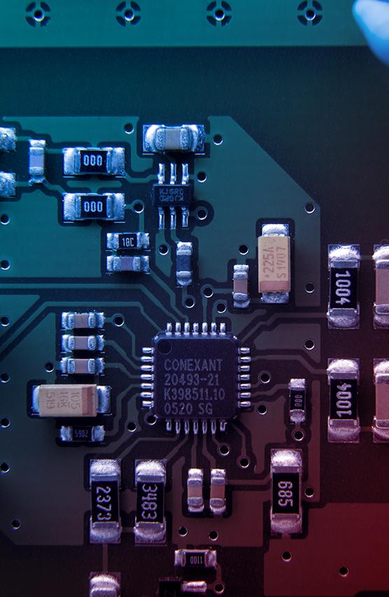
Thanks!

